Slide 1
CSCI 4/5588 ML-II Recommender Systems Chapter 07
Md Tamjidul Hoque
Notes:
[1] Book: Chapter 9 of “Mining of Massive Datasets”, by Jure Leskovec, Anand Rajaraman and Jeff Ullman.
[2] Book: “Recommender Systems”, by Charu C. Aggarwal.
[3] Open-Source Tools for Recommender Systems, http://lenskit.org/, paper: https://arxiv.org/pdf/1809.03125.pdf

Slide 2
Presentation Overview
Overview of Recommender Systems
Content based Recommender Systems
Collaborative Filtering
Latent Factor based Recommender Systems
Evaluate Recommender Systems

Slide 3
Overview
The increasing applications of web-based businesses are driving the development of the recommender systems.
Web, enables users to provide feedback about their likes and dislikes.
Alternatively, user buying or browsing an item online, can be viewed as an expression of interest about the product.
Those aforementioned various sources of data help to infer customers’ interests and help form the basis of the recommender systems.
The goal of the recommender systems is to predict high interest of a customer for a particular product in recommending the product for that customer.

Slide 4
… Overview: why recommendation?
Scarcity [1]:
The shelf space is a scarce commodity for traditional retailers - e.g. Walmart.
Also: TV networks, movie theaters,…
From scarcity to abundance:
Web enables near-zero-cost dissemination of information about products.
More choice necessitates better filters
Recommendation engines emerged
See, how Into Thin Air made Touching the Void a bestseller: https://www.wired.com/2004/10/tail/

Slide 5
… Overview: The Long Tail Phenomenon?
Physical stores have limited shelf space and can show the customer only a small fraction of all the choices that exist.
In contrast, online stores can make anything that exists, available to the customer.
Example (1): Thus, a physical bookstore may have several thousand books on its shelves, but Amazon offers millions of books.
Example (2): A physical newspaper can print several dozen articles per day, while online news services offer thousands per day.

Slide 6
… Overview: The Long Tail Phenomenon?
Recommendation in the physical world is fairly simple, because:
It is not possible to tailor the store to each individual customer.
The choice of what is made available is governed only by the aggregate numbers.
Typically, a bookstore will display only the books that are most popular - so, sales figures govern the choices.
A newspaper will print only the articles it believes the most people will be interested in - editorial judgement serves.

Slide 7
… Overview: The Long Tail Phenomenon?
The distinction between the physical and online worlds has been called the long tail phenomenon (see Fig. below):
Physical and online shops
For online, it is not possible to present all available items to the user, the way physical institutions can.
We cannot expect users to have heard of each of the items they might like.
Thus, the long-tail phenomenon forces online institutions to recommend items to individual users.
cutoff point
Popularity →
Online shops only – the AUC can be very large.
← Item ranked by popularity
Figure: The long tail: physical institutions can only provide what is popular, while on-line institutions can make everything available.

Slide 8
Types of Recommendations
Editorial and hand curated [1]
List of favorites
Lists of “essential” items
Simple aggregates
Manager’s special,
Top 10,
Most Popular,
Recent Uploads
Tailored to individual users
Amazon.com’s recommendation system
Netflix movie recommendation system
Google news personalization system
Facebook friend recommendations

Slide 9
Formulation of the Recommendation Problem
Prediction problem: To predict the rating value for a user-item combination, assuming the training data of user preferences is available.
For m users and n items, this corresponds to an incomplete m × n matrix, where the observed values are used for training. The missing values are predicted using this training model.
Ranking problem: Here, a seller may want to recommend the top-k items for a particular user or determine the top-k users to target for a particular item.

Slide 10
Classification of Recommendation Systems
Content-based systems:
It examines the properties of the items recommended.
Example: if a Netflix user has watched many cowboy movies, then recommend a movie classified in the database as having the “cowboy” genre or style.
Collaborative filtering systems:
It recommends items based on similarity measures between users and/or items.
The items recommended to a user are those preferred by similar users.

Slide 11
Formal Model
X = set of Customers [1]
S = set of Items
Utility function u: X × S → R
R = set of ratings
R is a totally ordered set
e.g., 0-5 stars, real number in [0,1]

Slide 12
Utility Matrix
Users have preferences for certain items which is presented as user-item pair in a utility matrix:
each entry represents the degree of preference of that user for that item.
Example: integers 1-5 can represent the number of stars that the user gave as a rating for the item.

Slide 13
… Utility Matrix
Example:
Fig: A utility matrix representing ratings of movies on a 1–5 scale.
Here, in the 1-5 scale, 5 is the highest rating.
Blanks represent the situation where the user has not rated the movie.
The movie names are HP1, HP2, and HP3 for Harry Potter I, II, and III, TW for Twilight, and SW1, SW2, and SW3 for Star Wars episodes 1, 2, and 3.
The users are represented by capital letters A through D.

Slide 14
… Utility Matrix
The goal of the recommender system is to predict the blanks in the utility matrix.
Example: would user A like SW2?
We might design our recommendation system to take into account properties of movies, such as their producer, director, stars, or even the similarity of their names.
If so, we might then note the similarity between SW1 and SW2, and then conclude that since A did not like SW1, A would not enjoy SW2 either.
Alternatively, with much more data, we might observe that the people who rated both SW1 and SW2, tended to give them similar ratings. Thus, we could conclude that A would also give SW2 a low rating, similar to A’s rating of SW1.

Slide 15
Key Problems
Initialization or, Gathering “known” ratings for matrix [1]
How to collect the data in the utility matrix
Extrapolate unknown ratings from the known ones
Mainly interested in high unknown ratings
We are not interested in knowing what customers don’t like but what customers like
Evaluating extrapolation methods
How to measure success/performance of recommendation methods

Slide 16
Initialization or, Gathering Ratings
Explicit [1]
Ask people to rate items: 1-5, 1-10, 0-1.
Excellent data but insufficient: Doesn’t scale well in practice –
people can’t be bothered, and they are often very reluctant to rate
Implicit
Learn ratings from users’ actions
E.g., purchase implies high rating
This approach scales well, as it does not rely on customer’s explicit rating.
What about low ratings?
Not possible to learn low rating. ‘Not purchased’ does not imply ‘low rating’
Finally, we can combine explicit and implicit approaches.

Slide 17
Extrapolating Utilities
Key problem: Utility matrix U is sparse [1]
Most people have not rated most items
Cold start:
New items have no ratings
New users have no history
Three approaches to recommender systems:
1) Content-based
2) Collaborative filtering
3) Latent factor based

Slide 18

Content-based Recommender Systems
Next

Slide 19
Content-based Recommendations
Main idea [1]: Recommend items to customer x similar to previous items rated highly by x
Example:
Movie recommendations
Recommend movies with same actor(s), director, genre, …
Websites, blogs, news
Recommend other sites with “similar” content

Slide 20
Plan of Action
Item profiles [1]
likes
build
recommend
match
Red
Circles
Triangles
User profile

Slide 21
Item Profiles
For each item, create an item profile
Profile is a set (vector) of features
For Movies it could be:
a set of actors, and/or,
a set of directors, and/or,
the year when the movie was made, and/or,
the genre or general type: comedies, romances … machine learning point of view, we can utilize the Internet Movie Database (IMDB) that assigns a genre or genres to every movies.
For Text it could be: a Set of “important” words in document.
How to pick important features?
Usual heuristic from text mining is to get higher TF-IDF (Term frequency * Inverse Doc Frequency)
For example, in a news article, we would expect the words with the highest TF.IDF score to include the names of people discussed in the article, unusual properties of the event described, and the location of the event.

Slide 22
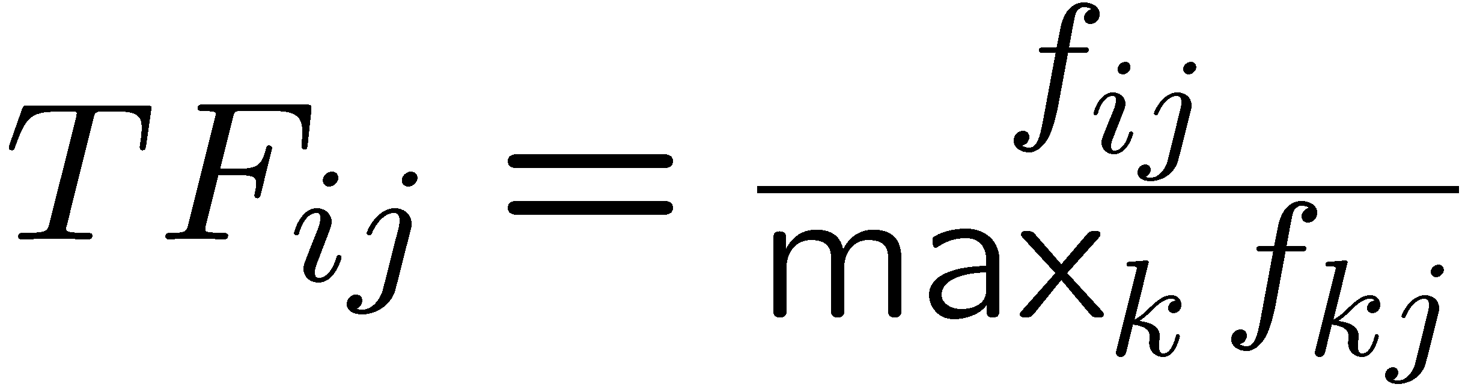
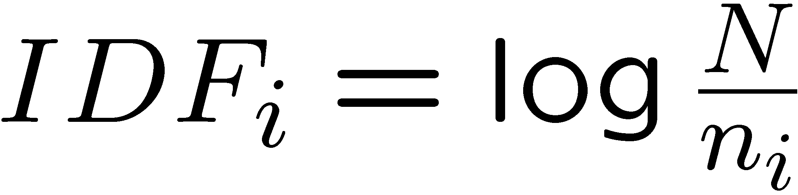
Item Profile: TF-IDF
f_{ij} = frequency of term (feature) i in doc (item) j [1]
n_{i} = number of docs that mention term i
N = total number of docs
TF-IDF score: w_{ij} = TF_{ij} × IDF_{i}
Doc profile = set of words with highest TF-IDF scores, together with their scores
Note: we normalize TF to discount for “longer” documents

Slide 23
Item Profile: Obtaining Item Features From Tags
Let us consider a database of images, as an example of a way that features have been obtained for items.
The problem with images is that their data, typically an array of pixels, does not tell us anything useful about their features.
We can calculate simple properties of pixels, such as the average amount of red in the picture, but few users are looking for red pictures or especially like red pictures.
There have been a number of attempts to obtain information about features of items by inviting users to tag the items by entering words or phrases that describe the item.
Also, different person has different perception while tagging and the distinction is not something that could be discovered by existing image-analysis programs.

Slide 24
… Obtaining Item Features From Tags
del.icio.us (now part of Yahoo!) invited users to tag Web pages.
The goal of this tagging was to make a new method of search available, where users entered a set of tags as their search query, and the system retrieved the Web pages that had been tagged that way.
However, it is also possible to use the tags as a recommendation system. If it is observed that a user bookmarks many pages with a certain set of tags, then we can recommend other pages with the same tags.
The problem with tagging as an approach to feature discovery is that the process only works if users are willing to take the trouble to create the tags, and there are enough tags that occasional erroneous ones will not bias the system too much.
With the recent trend of development of sophisticated software, in near future, tagging could be a promising approach for effective recommendation systems specially for images, movies, music etc.

Slide 25
Item Profile: Representing Item Profiles
Item profile is expected to have feature-value pairs.
Example, for text, we can have a vector of 0’s and 1’s, where a 1 represented the occurrence of a high-TF.IDF word in the document. Since features for documents were all words, it is easy to represent profiles this way.
For movies, if one feature is the set of actors, then for each actor, a 1 indicates if that actor is in the movie, and 0 if not. Likewise, we can have a component for each possible director, and each possible genre. All these features can be represented using only 0’s and 1’s.
Numerical features should be represented by single components of vectors representing items, for example, we might take the average rating for movies to be a feature and this average is a real number.

Slide 26
… Item Profile: Representing Item Profiles
There is no harm if some components of the vectors are boolean and others are real-valued or integer-valued.
The goal is to compute similarity between vectors by particularly applying cosine distance between vectors and we should apply appropriate scaling of the non-boolean components, so that they neither dominate the calculation nor are they irrelevant.
Important Note (1): While comparing for similarity, there are in principle an infinite number of additional components, each with 0’s for both vectors, representing all the possible actors that neither movie has for example.
Important Note (2): Since cosine distance of vectors is not affected by components in which both vectors have 0, we need not worry about the effect of actors that are in neither movie.

Slide 27
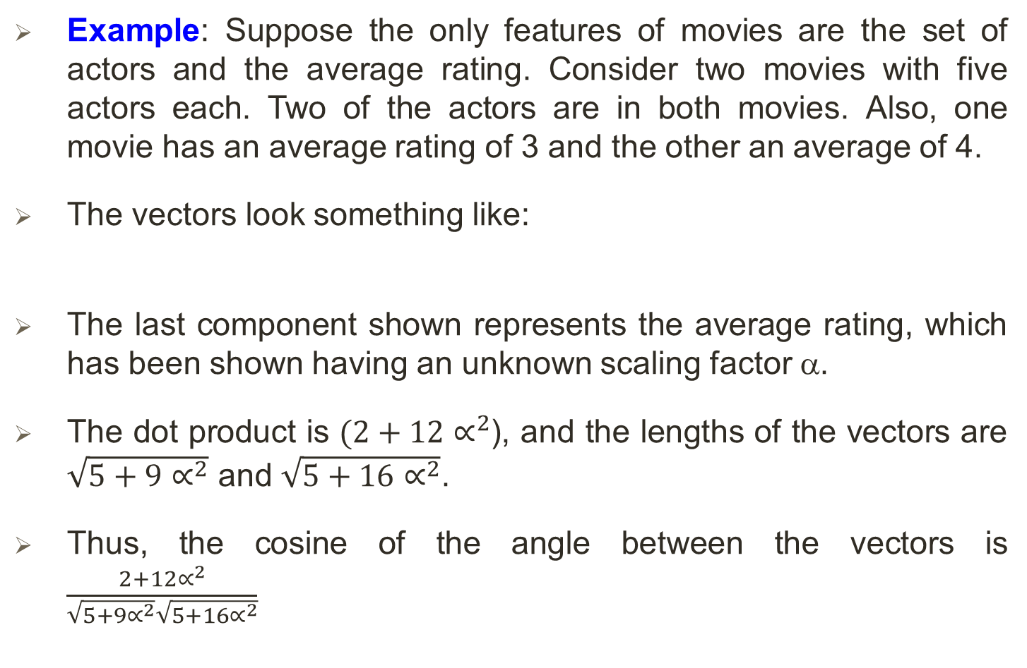
… Item Profile: Representing Item Profiles
Example: Suppose the only features of movies are the set of actors and the average rating. Consider two movies with five actors each. Two of the actors are in both movies. Also, one movie has an average rating of 3 and the other an average of 4.
The vectors look something like:
The last component shown represents the average rating, which has been shown having an unknown scaling factor α.
The dot product is $(2+12∝^{2}$), and the lengths of the vectors are $\sqrt{5+9∝^{2}}$ and $\sqrt{5+16∝^{2}}$.
Thus, the cosine of the angle between the vectors is $\frac{2+12∝^{2}}{\sqrt{5+9∝^{2}}\sqrt{5+16∝^{2}}}$

Slide 28
… Item Profile: Representing Item Profiles
If we choose α = 1, that is, we take the average ratings as they are, then the value of the above expression is 0.816.
If we use α = 2, that is, we double the ratings, then the cosine is 0.940.
That is, the vectors appear much closer in direction than if we use α = 1.
Likewise, if we use α = 1/2, then the cosine is 0.619, making the vectors look quite different.
We cannot tell which value of α is “right,” directly but we see that the choice of scaling factor for numerical features affects our decision about how similar items are.

Slide 29
User Profiles
We not only need to create vectors describing items; we need to create vectors with the same components that describe the user’s preferences.
User profile possibilities:
With the item vector, we can estimate regarding which items the user likes is some aggregation of the profiles of those items.
If the utility matrix has only 1’s, then the natural aggregate is the average of the components of the vectors representing the item profiles for the items in which the utility matrix has 1 for that user.
Or, Weighted average of rated item profiles.
Variation: weight by difference from average rating for item.

Slide 30
… User Profiles
Example (1): Suppose items are movies, represented by boolean profiles with components corresponding to actors. Also, the utility matrix has a 1 if the user has seen the movie and is blank otherwise.
If 20% of the movies that user U likes have Eddie Murphy as one of the actors, then the user profile for U will have 0.2 in the component for Eddie Murphy.
If the utility matrix is not boolean, e.g., ratings 1–5, then we can weight the vectors representing the profiles of items by the utility value.
It makes sense to normalize the utilities by subtracting the average value for a user. That way, we get negative weights for items with a below-average rating, and positive weights for items with above-average ratings. This approach is very useful (discussed later).

Slide 31
… User Profiles
Example (2): suppose the utility matrix has nonblank entries that are movie ratings in the 1–5 range. Suppose user U gives an average rating of 3. There are three movies with Eddie Murphy as an actor, and those movies got ratings of 3, 4, and 5.
Then in the user profile of U, the component for Eddie Murphy will have value that is the average of 3 − 3, 4 − 3, and 5 − 3, that is, a value of 1 (because ({0+1+2}/3).
Similarly, user V gives an average rating of 4, and has also rated three movies with Eddie Murphy (it doesn’t matter whether or not they are the same three movies U rated).
User V gives these three movies ratings of 2, 3, and 5.
The user profile for V has, in the component for Eddie Murphy, the average of 2 − 4, 3 − 4, and 5 − 4, that is, the value −2/3.

Slide 32

Recommending Items to User based on Content
Prediction heuristic:
Given user profile x and item profile i,
the estimated preference $=cos⁡(x,i) = \frac{x·i}{|\left|x\right||⋅|\left|i\right||}$

Slide 33
Pros: Content-based Approach
+: No need for data on other users
No cold-start or sparsity problems
+: Able to recommend to users with unique tastes
+: Able to recommend new & unpopular items
No first-rater problem
+: Able to provide explanations
Can provide explanations of recommended items by listing content-features that caused an item to be recommended

Slide 34
Cons: Content-based Approach
–: Finding the appropriate features is hard
E.g., images, movies, music
–: Recommendations for new users
How to build a user profile?
–: Overspecialization
Never recommends items outside user’s content profile
People might have multiple interests
Unable to exploit quality judgments of other users

Slide 35
Collaborative Filtering - Harnessing judgments of other similar users
Next

Slide 36
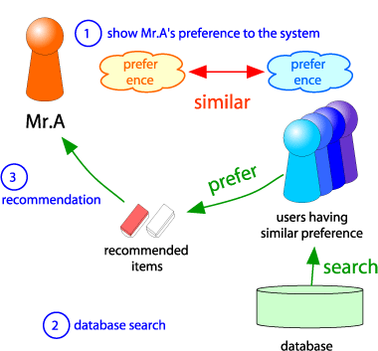
Collaborative Filtering (CF)
Consider user x
Find set N of other users whose ratings are “similar” to x’s ratings
Estimate x’s ratings based on ratings of users in N
x
N
Notes:
Ref [1]

Slide 37
Finding Similar Users
Example:
Observe specifically the users A and C.
A & C rated two movies in common, but they appear to have almost completely opposite opinions of these movies, compared to A & B (where they rated one movie in common).
We would expect that a good distance measure would make them rather far apart.

Slide 38
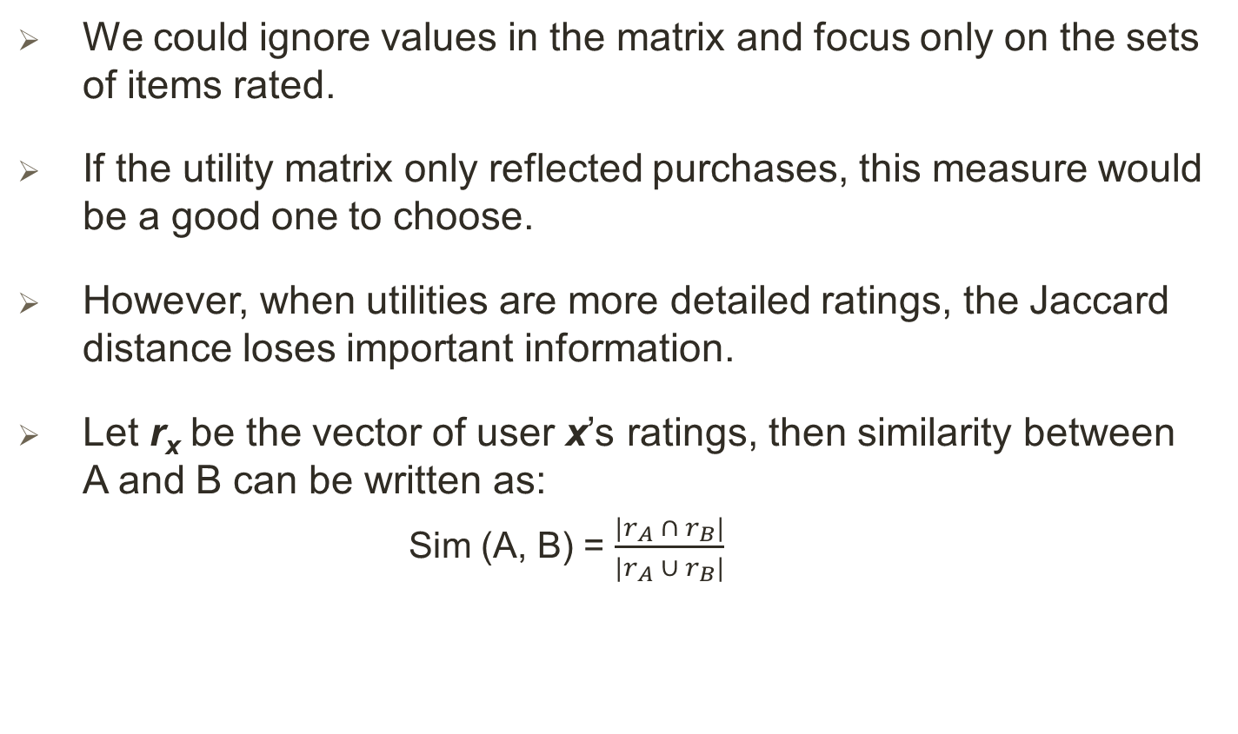
… Finding Similar Users: Jaccard Distance
We could ignore values in the matrix and focus only on the sets of items rated.
If the utility matrix only reflected purchases, this measure would be a good one to choose.
However, when utilities are more detailed ratings, the Jaccard distance loses important information.
Let r_{x} be the vector of user x’s ratings, then similarity between A and B can be written as:
Sim (A, B) = $\frac{|r_{A} ∩ r_{B}|}{|r_{A} ∪ r_{B}|}$

Slide 39
… Finding Similar Users: Jaccard Distance
Example: (see Table in slide #37) A and B have an intersection of size 1 and a union of size 5.
Thus, A & B‘s Jaccard similarity is 1/5, and their Jaccard distance is 4/5; i.e., they are very far apart.
In comparison, A and C have a Jaccard similarity of 2/4, so their Jaccard distance is the same, 1/2.
Thus, A appears closer to C than to B.
Yet that conclusion seems intuitively wrong. A and C disagree on the two movies they both watched, while A and B seem both to have liked the one movie they watched in common.
Jaccard dist. is NOT appropriate as we want to consider weights.

Slide 40
… Finding Similar Users: Cosine Distance
We can treat blanks as a 0 value.
The above choice is questionable, since it has the effect of treating the lack of a rating as more similar to disliking the movie than liking it.
Example (see Table in slide #37):
The cosine of the angle between A and B is
The cosine of the angle between A and C is
Here, Sim(A, B) > Sim (A, C) but marginal.
Sim (A, B)=
Sim (A, C)=

Slide 41
… Finding Similar Users: Normalizing Ratings
We can normalize ratings, by subtracting from each rating the average rating of that user.
Thus, we turn low ratings into negative numbers and high ratings into positive numbers.
If we then take the cosine distance, we find that users with opposite views of the movies they viewed in common will have vectors in almost opposite directions, and can be considered as far apart as possible.
However, users with similar opinions about the movies rated in common will have a relatively small angle between them.

Slide 42
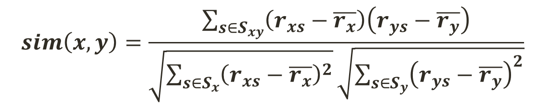
… Finding Similar Users: Normalizing Ratings
This normalized rating in fact is Pearson correlation coefficient (PCC).
If S_{xy} = items rated by both users x and y; and
S_{x} = items rated by user x,
$$sim\left(x,y\right)=\frac{\sum_{s∈S_{xy}}{\left(r_{xs}−\overline{r_{x}}\right)\left(r_{ys}−\overline{r_{y}}\right)}}{\sqrt{\sum_{s∈S_{x}}{{\left(r_{xs}−\overline{r_{x}}\right)}^{2}}}\sqrt{\sum_{s∈S_{y}}{{\left(r_{ys}−\overline{r_{y}}\right)}^{2}}}}$$
where, $\overline{r_{x} }$, $\overline{r_{y} }$ are the avg. rating of x, y respectively.

Slide 43
… Finding Similar Users: Normalizing Ratings
Example: by subtracting the (row) mean from the table in slide 37, it becomes:
Now, the cosine of the angle between A and B:
Now, the cosine of the angle between A and C:
Sim (A, B)=
Sim (A, C)=

Slide 44
… Finding Similar Users: Normalizing Ratings
Notice that under this measure, A and C are much further apart than A and B.
Both these observations make intuitive sense, given that A and C disagree on the two movies they rated in common, while A and B give similar scores to the one movie they rated in common.

Slide 45
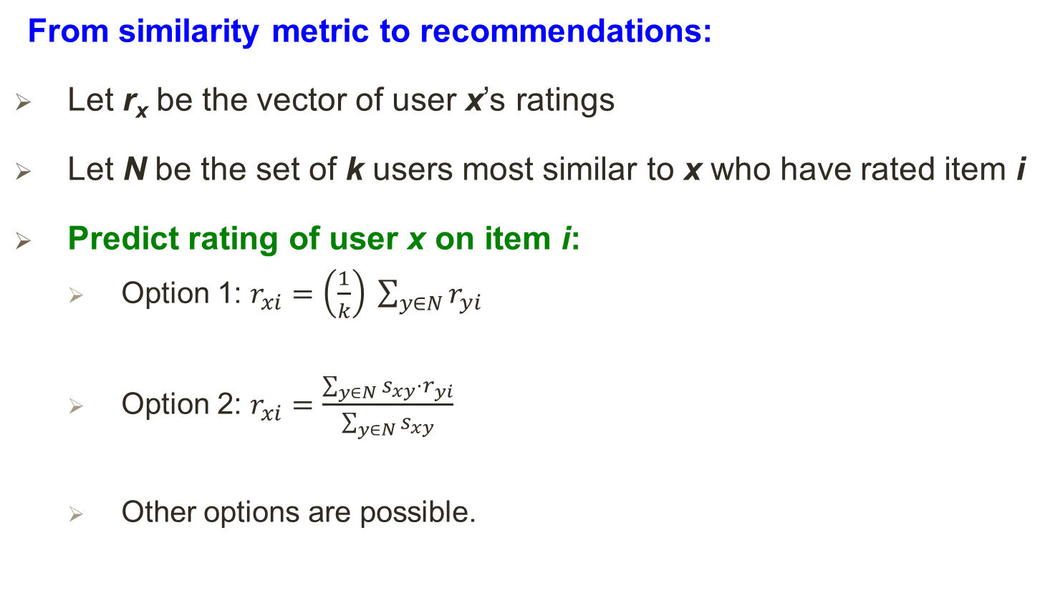

Rating Predictions
From similarity metric to recommendations:
Let r_{x} be the vector of user x’s ratings
Let N be the set of k users most similar to x who have rated item i
Predict rating of user x on item i:
Option 1: $r_{xi}=\left(\frac{1}{k}\right) \sum_{y∈N}{r_{yi}}$
Option 2: $r_{xi}=\frac{\sum_{y∈N}{s_{xy}⋅r_{yi}}}{\sum_{y∈N}{s_{xy}}}$
Other options are possible.
where, $s_{xy}=sim\left(x,y\right)$

Slide 46
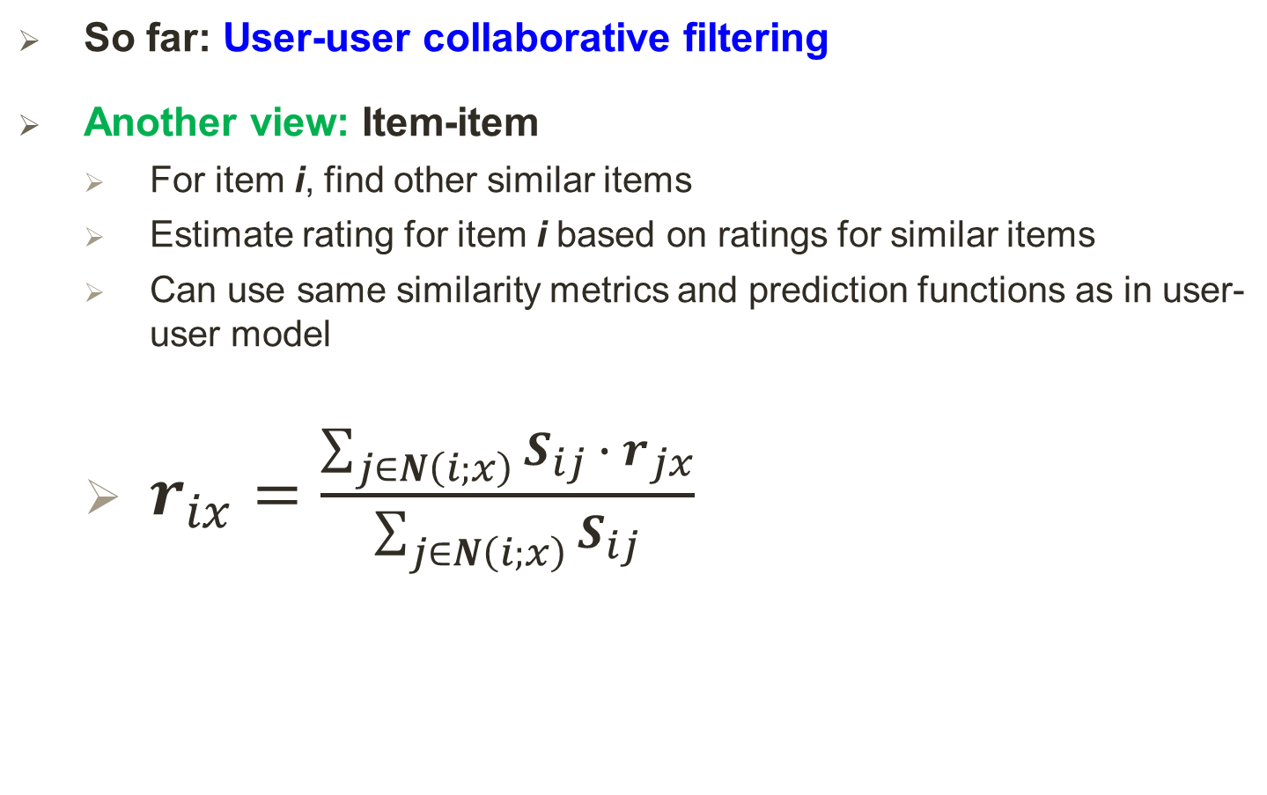
Item-Item Collaborative Filtering
So far: User-user collaborative filtering
Another view: Item-item
For item i, find other similar items
Estimate rating for item i based on ratings for similar items
Can use same similarity metrics and prediction functions as in user-user model
$r_{ix}=\frac{\sum_{j∈N\left(i;x\right)}{S_{ij} ∙ r_{jx}}}{\sum_{j∈N\left(i;x\right)}{S_{ij}}}$
where,
S_{ij} = similarity of items i and j
r_{ix} = rating of user x on item i
N(i;x) = set items rated by x similar to i

Slide 47
Item-Item CF (|N|=2)
users
12 | 11 | 10 | 9 | 8 | 7 | 6 | 5 | 4 | 3 | 2 | 1
 | 4 |  | 5 |  |  | 5 |  |  | 3 |  | 1 | 1
3 | 1 | 2 |  |  | 4 |  |  | 4 | 5 |  |  | 2
 | 5 | 3 | 4 |  | 3 |  | 2 | 1 |  | 4 | 2 | 3
 | 2 |  |  | 4 |  |  | 5 |  | 4 | 2 |  | 4
5 | 2 |  |  |  |  | 2 | 4 | 3 | 4 |  |  | 5
 | 4 |  |  | 2 |  |  | 3 |  | 3 |  | 1 | 6
movies
- unknown rating
- rating between 1 to 5
Notes:
Ref [1]
CF => Collaborative Filtering

Slide 48
Item-Item CF (|N|=2)
users
12 | 11 | 10 | 9 | 8 | 7 | 6 | 5 | 4 | 3 | 2 | 1
 | 4 |  | 5 |  |  | 5 | ? |  | 3 |  | 1 | 1
3 | 1 | 2 |  |  | 4 |  |  | 4 | 5 |  |  | 2
 | 5 | 3 | 4 |  | 3 |  | 2 | 1 |  | 4 | 2 | 3
 | 2 |  |  | 4 |  |  | 5 |  | 4 | 2 |  | 4
5 | 2 |  |  |  |  | 2 | 4 | 3 | 4 |  |  | 5
 | 4 |  |  | 2 |  |  | 3 |  | 3 |  | 1 | 6
movies
- estimate rating of movie 1 by user 5
Notes:
Ref [1]

Slide 49
Item-Item CF (|N|=2)
users
12 | 11 | 10 | 9 | 8 | 7 | 6 | 5 | 4 | 3 | 2 | 1
 | 4 |  | 5 |  |  | 5 | ? |  | 3 |  | 1 | 1
3 | 1 | 2 |  |  | 4 |  |  | 4 | 5 |  |  | 2
 | 5 | 3 | 4 |  | 3 |  | 2 | 1 |  | 4 | 2 | 3
 | 2 |  |  | 4 |  |  | 5 |  | 4 | 2 |  | 4
5 | 2 |  |  |  |  | 2 | 4 | 3 | 4 |  |  | 5
 | 4 |  |  | 2 |  |  | 3 |  | 3 |  | 1 | 6
Sim (1,m)
1.00
-0.18
0.41
-0.10
-0.31
0.59
movies
3
6
Neighbor selection: Identify movies similar to movie 1, rated by user 5
Here we use Pearson correlation as similarity:
1) Subtract mean rating m_{i} from each movie i m₁ = (1+3+5+5+4)/5 = 3.6 row 1: [-2.6, 0, -0.6, 0, 0, 1.4, 0, 0, 1.4, 0, 0.4, 0]
2) Compute cosine similarities between rows
Notes:
Ref [1]

Slide 50
Item-Item CF (|N|=2)
users
12 | 11 | 10 | 9 | 8 | 7 | 6 | 5 | 4 | 3 | 2 | 1
 | 4 |  | 5 |  |  | 5 | ? |  | 3 |  | 1 | 1
3 | 1 | 2 |  |  | 4 |  |  | 4 | 5 |  |  | 2
 | 5 | 3 | 4 |  | 3 |  | 2 | 1 |  | 4 | 2 | 3
 | 2 |  |  | 4 |  |  | 5 |  | 4 | 2 |  | 4
5 | 2 |  |  |  |  | 2 | 4 | 3 | 4 |  |  | 5
 | 4 |  |  | 2 |  |  | 3 |  | 3 |  | 1 | 6
sim(1,m)
1.00
-0.18
0.41
-0.10
-0.31
0.59
movies
Compute similarity weights: s_{1,3}=0.41, s_{1,6}=0.59
Notes:
Ref [1]

Slide 51
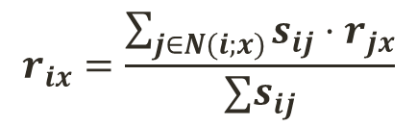
Item-Item CF (|N|=2)
users
12 | 11 | 10 | 9 | 8 | 7 | 6 | 5 | 4 | 3 | 2 | 1
 | 4 |  | 5 |  |  | 5 | 2.6 |  | 3 |  | 1 | 1
3 | 1 | 2 |  |  | 4 |  |  | 4 | 5 |  |  | 2
 | 5 | 3 | 4 |  | 3 |  | 2 | 1 |  | 4 | 2 | 3
 | 2 |  |  | 4 |  |  | 5 |  | 4 | 2 |  | 4
5 | 2 |  |  |  |  | 2 | 4 | 3 | 4 |  |  | 5
 | 4 |  |  | 2 |  |  | 3 |  | 3 |  | 1 | 6
movies
Predict by taking weighted average:
r_{1.5} = (0.41*2 + 0.59*3) / (0.41+0.59) = 2.6
$$r_{ix}=\frac{\sum_{j∈N(i;x)}{s_{ij}⋅r_{jx}}}{∑s_{ij}}$$
Notes:
Ref [1]

Slide 52
Pros/Cons of Collaborative Filtering
+ Works for any kind of item
No feature selection needed
- Cold Start:
Need enough users in the system to find a match
- Sparsity:
The user/ratings matrix is sparse
Hard to find users that have rated the same items
- First rater:
Cannot recommend an item that has not been previously rated
Thus, problem with: New items, Esoteric items
- Popularity bias:
Tends to recommend popular items
Cannot recommend items to someone with unique taste
Notes:
Ref [1]

Slide 53
Hybrid Methods
Add content-based methods to collaborative filtering
Item profiles for new item problem
Demographics to deal with new user problem
Implement two or more different recommenders and combine predictions
Perhaps using a linear model
e.g., Global baseline with Collaborative Filtering

Slide 54
Global Baseline Estimation (GBE)
Task: Estimate David’s rating for the movie, “The Lord of the Rings”
Problem: David has not rated any similar movie.
Findings: for “The Lord of the Rings” −
∀ (movies, users), the mean movie rating, μ = 3.2 stars.
Avg. rating of “The Lord …” is b_{i} = + 0.7  above average movies.
David is a b_{x} = - 0.4 , below average rater.
Therefore, baseline estimate rating = μ + b_{i} + b_{x}
= 3.2 + 0.7 - 0.4
= 3.5 .
Notes:
Ref [1]

Slide 55
Combine: CF with GBE
CF Approach:
assume, David does not like similar movie “The Hobbit”
David rated “The Hobbit” 1  below the average rating.
Then, therefore, a final estimate based on linear combination of GBE & CF = 3.5 -1
= 2.5 .
This linear combination of GBE & CF is, in fact, a common practice in CF.
Notes:
Ref [1]

Slide 56

Common Practice in CF
Define similarity s_{ij} of items i and j
Select k nearest neighbors N(i; x)
Items most similar to i, that were rated by x
Estimate rating r_{xi} as the weighted average:
baseline estimate for r_{xi}
μ = overall mean movie rating
b_{i} = rating deviation of movie i
b_{x} = rating deviation of user x
= (avg. rating of user x) – μ
$$b_{xi}=μ+b_{i}+b_{x}$$

Slide 57
… Common Practice in CF
Summary:
In CF,
instead of
,
is commonly used.

Slide 58
Evaluate Recommender Systems
Next

Slide 59
Evaluation
movies
1 | 3 | 4
 | 3 | 5 |  |  | 5
 |  | 4 | 5 |  | 5
 |  | 3
 |  | 3
2 |  |  | 2 |  | 2
 |  |  |  | 5
 | 2 | 1 |  |  | 1
 | 3 |  |  | 3
1
users
Notes:
Ref [1]

Slide 60
Evaluation
movies
1 | 3 | 4
 | 3 | 5 |  |  | 5
 |  | 4 | 5 |  | 5
 |  | 3
 |  | 3
2 |  |  | ? |  | ?
 |  |  |  | ?
 | 2 | 1 |  |  | ?
 | 3 |  |  | ?
1
users
Test Data Set
Notes:
Ref [1]

Slide 61
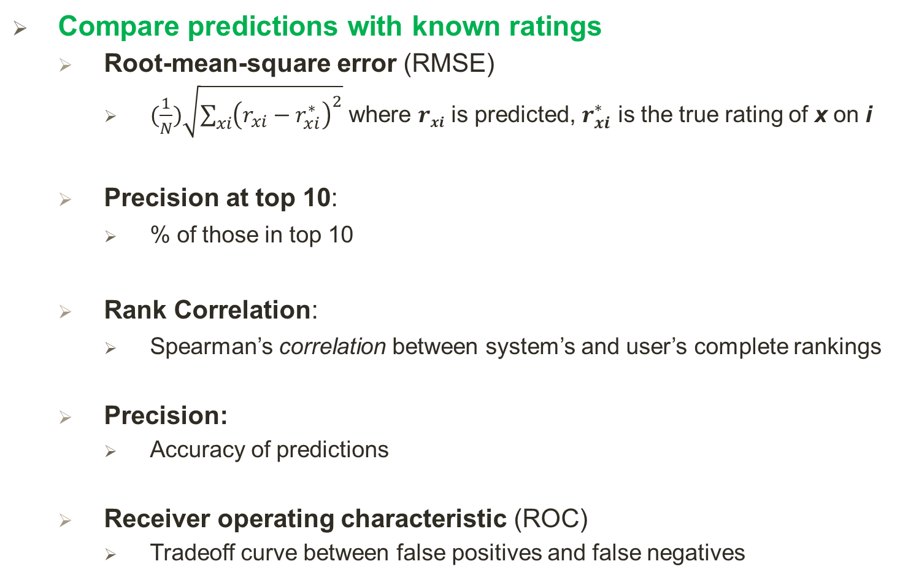
Evaluating Predictions
Compare predictions with known ratings
Root-mean-square error (RMSE)
$(\frac{1}{N})\sqrt{\sum_{xi}{{\left(r_{xi}−r_{xi}^{∗}\right)}^{2}}}$ where $rxi$ is predicted, $r_{xi}^{∗}$ is the true rating of x on i
Precision at top 10:
% of those in top 10
Rank Correlation:
Spearman’s correlation between system’s and user’s complete rankings
Precision:
Accuracy of predictions
Receiver operating characteristic (ROC)
Tradeoff curve between false positives and false negatives
Notes:
Ref [1].
The Spearman correlation between two variables is equal to the Pearson correlation between the rank values of those two variables; while Pearson's correlation assesses linear relationships, Spearman's correlation assesses monotonic relationships (whether linear or not).
A Spearman correlation of 1 results when the two variables being compared are monotonically related, even if their relationship is not linear [more, see wiki].

Slide 62
Problems with Error Measures
Narrow focus on accuracy sometimes misses the point
Prediction Diversity
Prediction Context
Order of predictions
In practice, we care only to predict high ratings:
RMSE might penalize a method that does well for high ratings and badly for others
Notes:
Ref [1]

Slide 63
Collaborative Filtering: Complexity
Expensive step is finding k most similar customers: O(|X|)
where, X is the set of customers
Naïve pre-computation takes time O(k ·|X|)
Too expensive to do at runtime
Could pre-compute
Reduction in time complexity by the followings:
Near-neighbor search in high dimensions (LSH: Locality Sensitive Hashing)
Clustering (will be discussed next)
Dimensionality reduction (will be discussed next)
Notes:
Ref [1]

Slide 64
Remarks
Leverage all the data
Don’t try to reduce data size in an effort to make fancy algorithms work
Simple methods on large data do best
Add more data
Run tools to generate useful features
e.g., add IMDB data on genres
Data is gold in data-mining –
More data beats better algorithms,
See: http://anand.typepad.com/datawocky/2008/03/more-data-usual.html
Notes:
Ref [1]

Slide 65
Improve Recommender Systems
Next

Slide 66
Clustering Users and Items
It is hard to detect similarity among either items or users, because we have little information about user-item pairs in the sparse utility matrix.
To improve, we can cluster items and/or users based on an effective similarity/distance measure.
Example:
Then, we can have user cluster by averaging the ratings of the users in the cluster.
We can repeatedly cluster items and then users, to get our desired size of the utility matrix.
Utility matrix for users and clusters of items
The original utility matrix
Notes:
Ref [1]

Slide 67
… Clustering Users and Items
Using the cluster, for user U and item I in the original utility matrix, we can estimate the rating (of the blank entry) as follows:
Find the clusters to which U and I belong, say clusters C and D, respectively.
If the entry in the cluster-cluster utility matrix for C and D is something other than blank, use this value as the estimated value for the U - I entry in the original utility matrix.
If the entry for C–D is blank, then use an effective method (outlined before) to estimate that entry by considering clusters similar to C or D. Use the resulting estimate as the estimate for the U - I entry.
Notes:
Ref [1]

Slide 68
Dimensionality Reduction (Latent factor based)
This is an entirely different approach (called “UV-decomposition”) to estimating the blank entries in the utility matrix
Here, assume that the utility matrix is the product of two long, thin matrices.
Example:
M ( 5 × 5) =
U ( 5 × 2)
×
V ( 2 × 5)
Notes:
Ref [1]

Slide 69
… Dimensionality Reduction
Initialize U and V with arbitrary values as following and then find the produce is P:
U ( 5 × 2)
V ( 2 × 5)
= P ( 5 × 5)
Notes:
Ref [1]

Slide 70
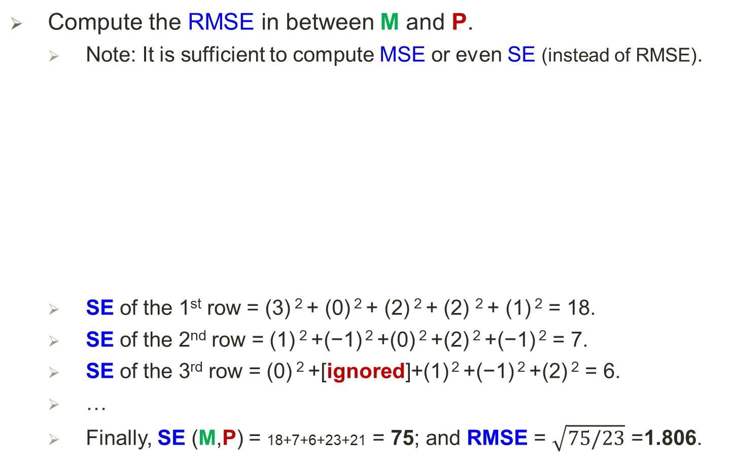
… Dimensionality Reduction
Compute the RMSE in between M and P.
Note: It is sufficient to compute MSE or even SE (instead of RMSE).
SE of the 1st row = (3) ² + (0) ² + (2) ² + (2) ² + (1) ² = 18.
SE of the 2nd row = (1) ² +(−1) ² +(0) ² +(2) ² +(−1) ² = 7.
SE of the 3rd row = (0) ² +[ignored]+(1) ² +(−1) ² +(2) ² = 6.
…
Finally, SE (M,P) = 18+7+6+23+21 = 75; and RMSE = $\sqrt{75/23}$ =1.806.
2
−
SE=
M
P
Notes:
Ref [1]
Why 23? Because for 5 x5 =25 matrix 2 items are missing.

Slide 71
… Dimensionality Reduction
Do incremental computation of a UV-Decomposition with a target to lower RMSE (SE):
To alter, u₁₁, we do the following:
SE of the 1st row is now:
We want the value of x that minimizes the sum, so we take the derivative and set that equal to 0, as:
=
=
=> x = 2.6.
Notes:
Ref [1]

Slide 72
… Dimensionality Reduction
With u₁₁ = 2.6, the SE (M,P) is reduced from 75 to 62.2.
Now, assume v₁₁ = y, and similarly:
Derivative of ( )= 0
By solving, we get, y = 1.617.
Notes:
Ref [1]

Slide 73
… Dimensionality Reduction
Now, assume u₃₁ = z, we get:
We can express the sum of the squares of the errors as:
(2−(1.617z + 1))² + [ignored] + (3 − (z + 1)) ² + (1 − (z + 1)) ² + (4 − (z + 1)) ²
Similarly, solving the derivative, we get, z = 1.178, ….
Continue optimization:
In order to reach a (local) minimum from a given starting value of U and V , we need to pick an order in which we visit the elements of U and V.
Say, we pick an order, e.g., row-by-row, for the elements of U and V, and visit them in round-robin fashion.
Notes:
Ref [1]

Slide 74
… Dimensionality Reduction
Converging to minimum:
Ideally, at some point the RMSE becomes 0 – actually, close to 0*.
While optimizing, we will need to take care to avoid overfitting by:
Early stopping, and/or,
Guided by test cases,
Take several different UV decompositions, and when predicting a new entry in the matrix M, take the average of the results of using each decomposition.
Now, from the final U and V, we can compute the blank value
m_{i,j} in M = (I ^{th} row of U) × (j ^{th} column of V)
Notes:
Ref [1]
* Close to 0 because, some of the ratings in the utility matrix are (is) blank.

Slide 75
The Netflix challenge and the winning strategy
Next

Slide 76
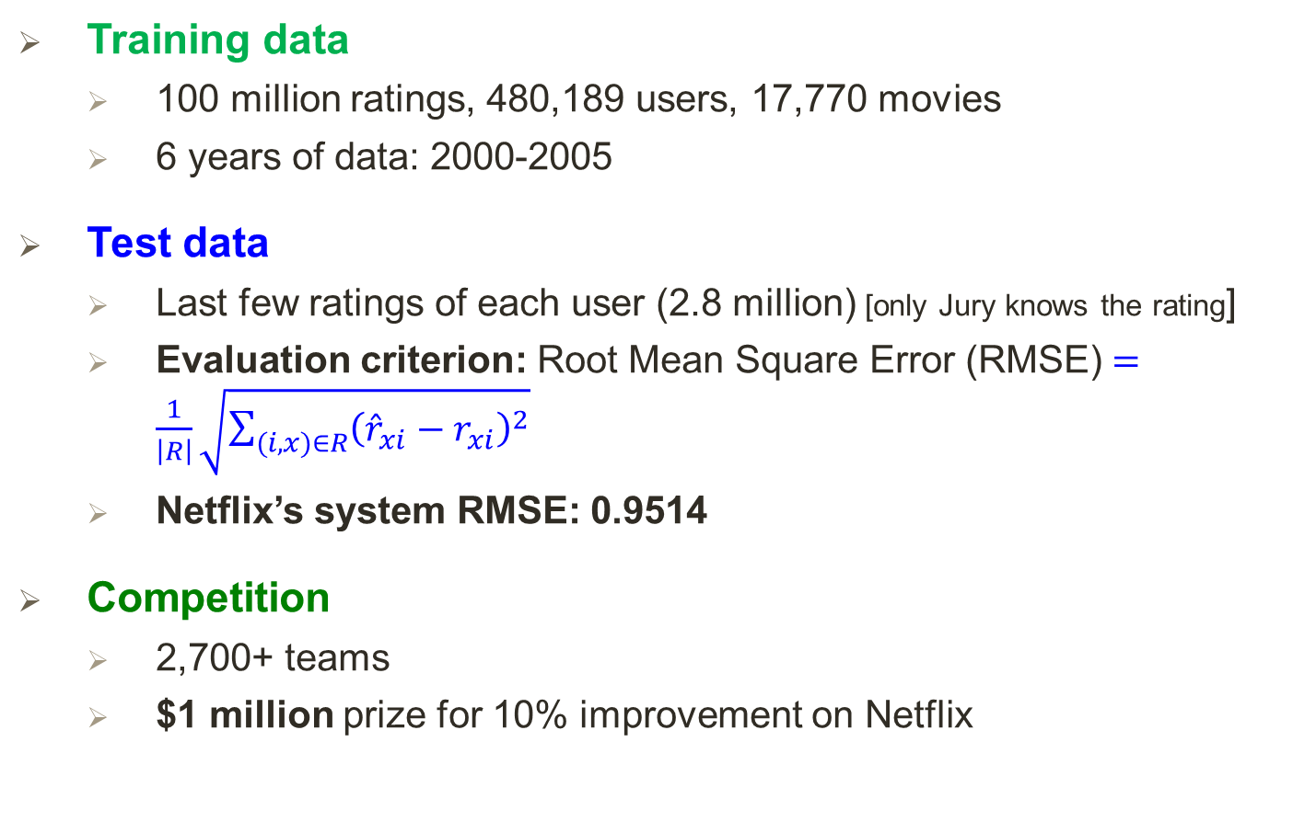
The Netflix Challenge
Training data
100 million ratings, 480,189 users, 17,770 movies
6 years of data: 2000-2005
Test data
Last few ratings of each user (2.8 million) [only Jury knows the rating]
Evaluation criterion: Root Mean Square Error (RMSE) $=\frac{1}{\left|R\right|}\sqrt{\sum_{(i,x)∈R}{{\left({\hat{r}}_{xi}−r_{xi}\right)}^{2}}}$
Netflix’s system RMSE: 0.9514
Competition
2,700+ teams
$1 million prize for 10% improvement on Netflix
Notes:
(1) Ref [1].
(2) [Wiki, https://en.wikipedia.org/wiki/Netflix_Prize]:
Netflix provided a training data set of 100,480,507 ratings that 480,189 users gave to 17,770 movies. Each training rating is a quadruplet of the form <user, movie, date of grade, grade>. The user and movie fields are integer IDs, while grades are from 1 to 5 (integral) stars.
The qualifying data set contains over 2,817,131 triplets of the form <user, movie, date of grade>, with grades known only to the jury.
Note:
RMSE needs to be reduced to improve. Initial RMSE is 0.9514.
Target RMSE should be <= (0.9514 X 90/100) = 0.85626‬.

Slide 77
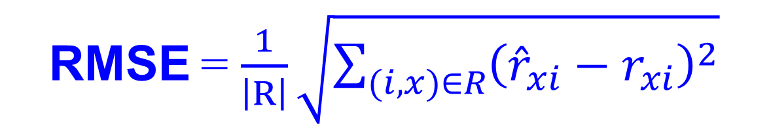

Utility Matrix R: Evaluation
480,000 users
Matrix R
1 | 3 | 4
 | 3 | 5 |  |  | 5
 |  | 4 | 5 |  | 5
 |  | 3
 |  | 3
2 |  |  | ? |  | ?
 |  |  |  | ?
 | 2 | 1 |  |  | ?
 | 3 |  |  | ?
1
$$r_{3,6}$$
17,700 movies
Training Data Set
Test Data Set
True rating of user x on item i
RMSE = $\frac{1}{\left|R\right|}\sqrt{\sum_{(i,x)∈R}{{\left({\hat{r}}_{xi}−r_{xi}\right)}^{2}}}$
Predicted rating

Slide 78
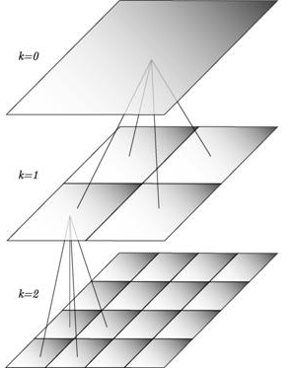
BellKor Recommender System
The winner of the Netflix Challenge!
Multi-scale modeling of the data: Combine top level, “regional” modeling of the data, with a refined, local view:
Global:
Overall deviations of users/movies
Factorization:
Addressing “regional” effects
Collaborative filtering:
Extract local patterns
Global effects
Factorization
Collaborative filtering
Notes:
Ref [1]

Slide 79
Performance of Various Methods
Netflix: 0.9514
Basic Collaborative filtering: 0.94
Collaborative filtering++: 0.91
Latent factors: 0.90
Latent factors+Biases: 0.89
Latent factors+Biases+Time: 0.876
Grand Prize: 0.8563
Notes:
Ref [1]
RMSE needs to be reduced to improve. Initial RMSE is 0.9514.
Target RMSE should be <= (0.9514 X 90/100) = 0.85626‬.

Slide 80
24 Hours from the Deadline
Submissions limited to 1 a day
Only 1 final submission could be made in the last 24hours
24 hours before deadline…
BellKor team member in Austria notices (by chance) that Ensemble posts a score that is slightly better than BellKor’s
Frantic last 24 hours for both teams
Much computer time on final optimization
Carefully calibrated to end about an hour before deadline
Final submissions
BellKor submits a little early (on purpose), 40 mins before deadline
Ensemble submits their final entry 20 mins after the BellKor
Notes:
Ref [1]

Slide 81
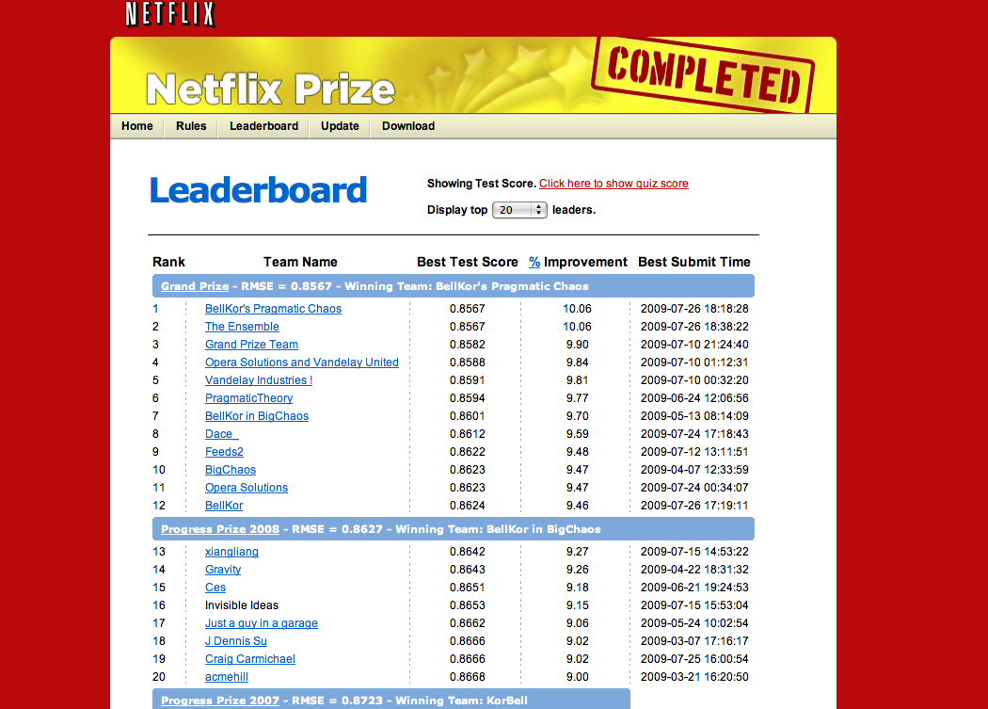
Notes:
Ref [1]

